Slide 1
Multi-Scale Modeling and Rendering of Granular Materials
Johannes Meng Disney Research Zürich and Karlsruhe Institute of Technology
Marios Papas Disney Research Zürich and ETH Zürich
Ralf Habel Disney Research Zürich
Carsten Dachsbacher Karlsruhe Institute of Technology
Steve Marschner Cornell University
Markus Gross Disney Research Zürich and ETH Zürich
Wojciech Jarosz Disney Research Zürich and Dartmouth College
Presenter:
Chao Zhang 200383834

Slide 2

1
Introduction
CONTENTS
2345
Granular Model and Algorithm Overview
6
Precomputation
7
Results
8
Conclusion

Slide 3
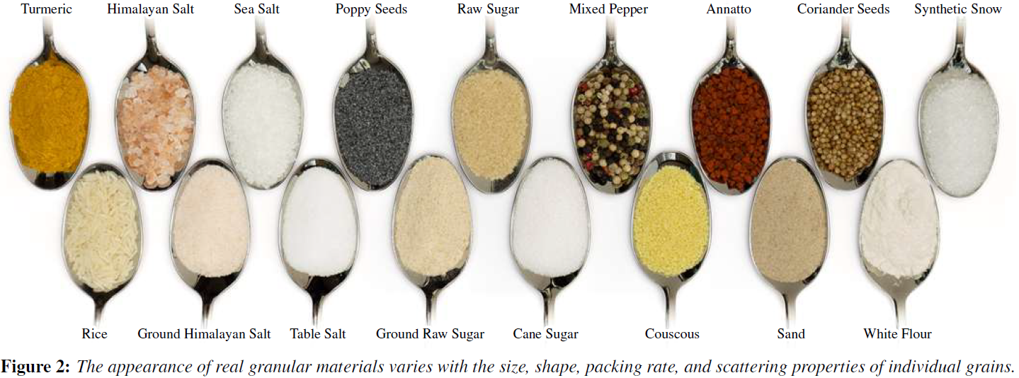
1 Introduction

Slide 4
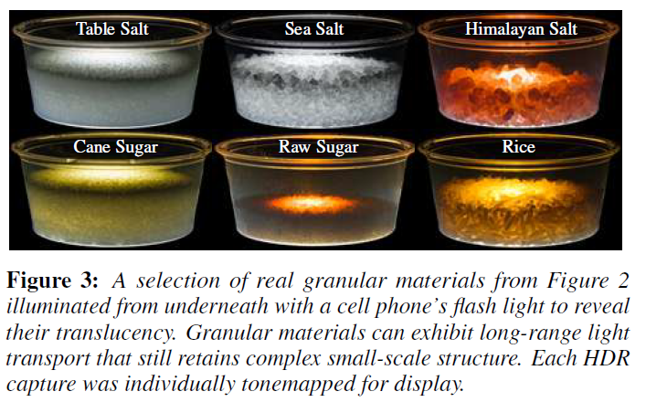
1 Introduction

Slide 5
Granular Model and Algorithm Overview
2,3,
4,5

Slide 6
2 Stochastic Granular Model
The random model for granular media consists of
a surface describing the boundary of the aggregate object,
a model for the geometry and material properties of individual grains, numbers describing the size and
packing rate of the grains composing the aggregate,
numbers defining the mixing weights if multiple grain types are used.

Slide 7
2 Stochastic Granular Model
The basic assumption is that the interior of the bounding surface is filled with many non-overlapping grains that are randomly positioned and oriented.
The goal of granular model is to procedurally define a random but repeatable collection of individual grains that fill the medium and do not intersect one another, while keeping memory requirements modest.

Slide 8
2.1 Tiled sphere packings
To avoid explicitly modeling and storing the arrangement of millions of packed grains, we rely on a procedurally tiled infinite field of packed spheres to fill the volume of the aggregate shape.
Each sphere contains one grain, and since the spheres do not overlap the grains cannot overlap. This approach greatly simplifies many parts of our system, but limits the maximum attainable packing fraction to approximately 0.634 for spherical grains and less for non-spherical grains. This is a limitation especially if the grains are highly non-spherical, such as grains of rice.

Slide 9
2.1 Tiled sphere packings
The basic building block of our procedural sphere packing is a tile, a
cuboid containing a number of non-intersecting spheres. We use the
algorithm to generate a dictionary of periodic tiles for various packing ratios f.

Slide 10
2.2 Randomized instantiation
We treat each distinct sphere of the infinite field as a location for instantiating a randomly chosen grain from the set of provided exemplars. The exemplar grains are chosen according to the user-specified mixing probabilities.
The aggregate mesh provided by the user defines the region in space where grains are instantiated and each instance is randomly rotated within its bounding sphere.

Slide 11
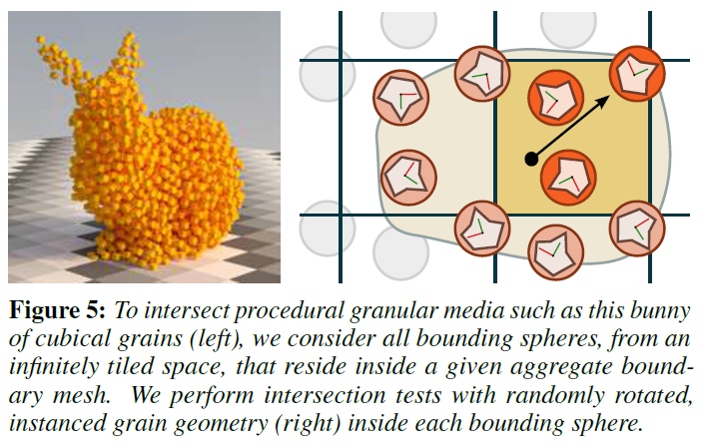
2.2 Randomized instantiation

Slide 12
3 Explicit Path Tracing
For the finest level, we use an algorithm which explicitly path traces
against the actual geometry of the individual grains generated by
the procedural model just described.
We call this technique explicit path tracing (EPT) and illustrate the expected input in Figure 4. The core challenge with this approach is representing the vast collection of grains and efficiently tracing rays through it.

Slide 13
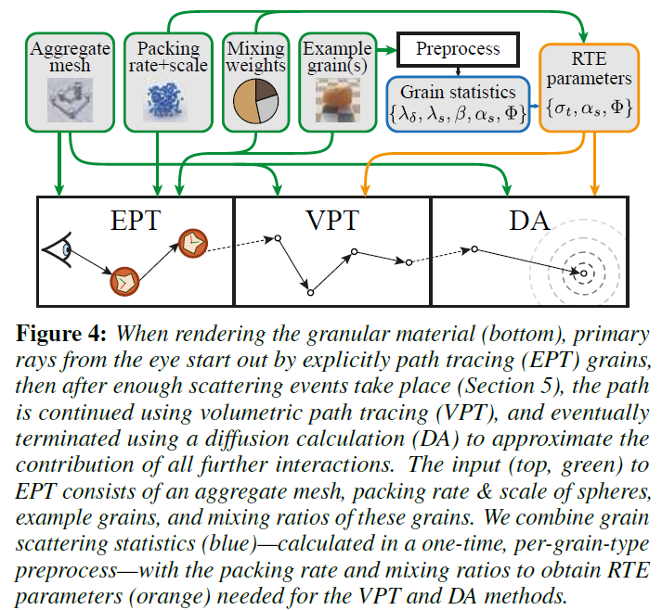
3 Explicit Path Tracing

Slide 14
3.1 Ray tracing grains
Even with instancing, storing the transformation matrices for the collection of billions of grain instances is impractical. Instead, we procedurally instantiate and discard the grains on demand during ray traversal of the scene.
To facilitate this, we voxelize the boundary mesh using two bits per voxel, marking voxels as either “fully outside,” “fully inside,” or “partially inside.” One voxel corresponds, in size and position, to one instance of the base tile.

Slide 15
3.1 Ray tracing grains
During ray tracing, we intersect the ray with the voxel grid to obtain
the first intersection with a voxel that is either “fully inside” or
“partially inside.” We then intersect the bounding spheres overlapping
the voxel. If the voxel is marked “fully inside,” we use the first
intersected bounding sphere. If it is marked “partially inside,” we
first have to determine if the bounding sphere’s center is contained
in the aggregate shape. We do this by tracing a ray from the sphere
center against the aggregate shape. If the bounding sphere is deemed
to be outside the aggregate shape, we proceed to the next bounding
sphere along the ray until a valid bounding sphere is found.

Slide 16
3.1 Ray tracing grains
Upon hitting a bounding sphere, we select a random example grain according to our mixing weights and temporarily transform the ray into the (randomly rotated) local coordinate system of the grain.
We then intersect the grain geometry to determine the final intersection point. If there is no intersection, we proceed to the next bounding sphere intersected by the ray (if any).

Slide 17
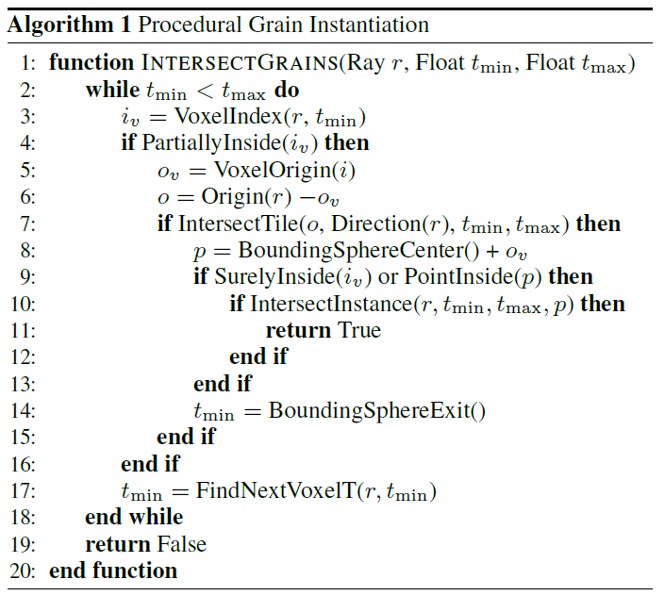
3.1 Ray tracing grains

Slide 18
3.2 Rendering
With this grain intersection machinery in place, we employ path tracing using next event estimation and multiple importance sampling as our finest level rendering technique. Note that while next event estimation may be useful outside the aggregate object and close to its boundary,
there are virtually no unblocked direct connections to light sources
from within the granular material.
Furthermore, most of our granular materials consist of grains with specular boundaries, rendering shadow rays useless and underpinning the need to switch to other approaches.

Slide 19
4 Volumetric Path Tracing
While EPT retains the necessary grain-level details present in low order scattering, it quickly becomes impractical for higher-order transport when rays become incoherent.
Luckily, for incoherent rays it is less important to precisely track which rays hit which grains, so we transit it to a continuous volumetric representation for medium-order transport, which we simulate using volumetric path tracing (VPT)

Slide 20
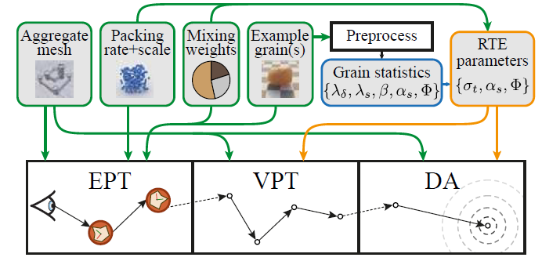
4 Volumetric Path Tracing
For this rendering approach we assume each bounding aggregate
shape is filled with an index-matched homogeneous participating
medium defined by its extinction coefficient , single-scattering
albedo , and the scattering phase function (cos ) (marked in
orange in Figure 4). The purpose is how to obtain these parameters from the properties of the granular packing for VPT.

Slide 21
4 Volumetric Path Tracing
Apart from the fact that VPT does not need to instance or intersect
grain geometry, transiting to VPT allows us to use shadow
connections from inside the granular medium, which was virtually
impossible with EPT.
As we will see in snow, this allows VPT to efficiently render scenes that are intrinsically hard for EPT, such as large aggregates of highly specular, non-absorbing grains.

Slide 22
5 Diffusion Approximation
While VPT has significantly lower variance than EPT, it can still
be computationally expensive for highly scattering materials which
require long transport paths. We therefore transition (see Figure 4) to
a rendering technique based on a fast diffusion approximation to account for large-scale transport due to high-order multiple scattering. Diffusion allows us to effectively short-circuit the recursion of VPT and approximate long scattering paths directly.

Slide 23
Importance of Using a Hybrid Method
We wish to render granular materials at multiple scales, potentially
in a single shot, using EPT alone would likely be prohibitively expensive, while the more approximate techniques would not faithfully reproduce fine surface details where individual grains are discernible.
One of our core contributions is showing how to systematically combine these disparate methods and representations to ensure visual consistency between grains visible at vastly different scales both across the image or across time in an animation.

Slide 24
6 Precomputation and RTE Parameters
Our goal in this section is to derive RTE parameters ( , , )
for a classical homogeneous medium which match the statistical
scattering behavior of the discrete granular material.

Slide 25
6.1 The Teleportation Transport Model
With this analogy in mind, our TT model consists of two core steps
which occur in alternation.
The first step considers inter-grain transport by randomly deciding how far along a ray to move before the next interaction with a grain bounding sphere occurs.
Upon hitting a bounding sphere, the second step considers intra-grain
transport by scattering and “teleporting” the ray directly to a point
where it exits the sphere.

Slide 26
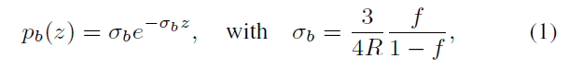
6.1.1 Inter-grain transport
Dixmier derived a simple model for free-flight distances in sphere packings, known in that context as outer chordlength distributions. He showed that these outer chord-lengths can be modeled by an exponential distribution
where R is the radius of the spheres, f is the sphere packing rate,
and = 1/ is the average distance between bounding sphere interactions.

Slide 27
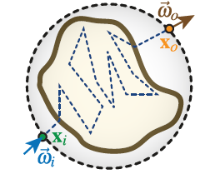
6.1.2 Intra-grain transport
The points and directions upon entering (x_{i}, ) and exiting (x_{o}, ) the bounding sphere characterize the scattering function S(x_{i}, x_{o}, ) of the grain. We call this function the teleportation scattering distribution function (TSDF), because it models scattering on a single grain by “teleporting” a photon from x_{i} to x_{o}

Slide 28
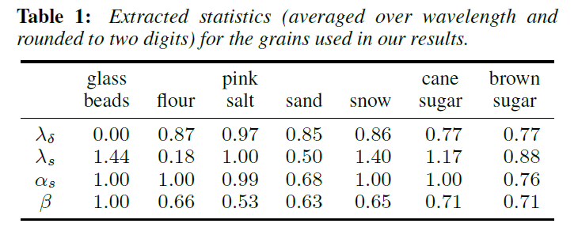
6.2 Effective RTE and Diffusion Parameters

Slide 29
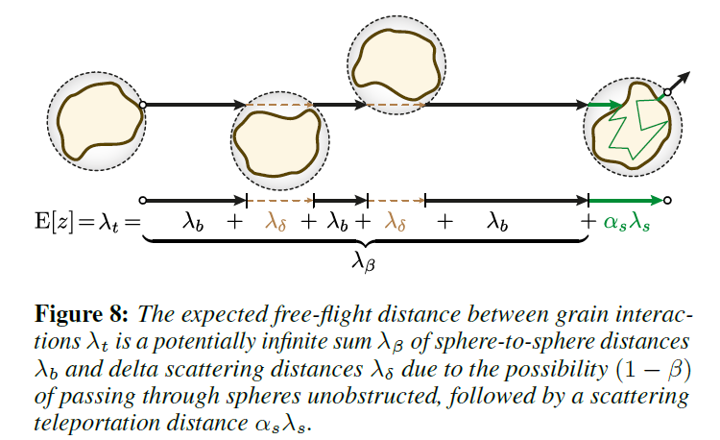
6.2 Effective RTE and Diffusion Parameters

Slide 30
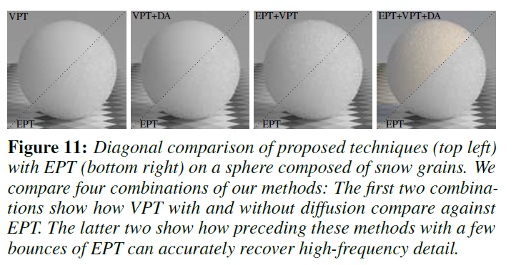
6.3 Switching between Rendering Techniques
EPT --> VPT
VPT --> DA
High Order
Acceptance Rate

Slide 31
7 Results
We implemented our method in Mitsuba as a new Integrator for our rendering algorithms and a new Shape primitive for our granular volumes. We rendered all results on a homogeneous cluster with nodes containing two 12-core Intel Xeon E5-2697v2 processors at 2.7 GHz with 64GB RAM and report all render times in core-hours. For time related comparisons, we independently render many low sample count images across the machines and average the resulting floating-point images for the
final result. In all results, RGB channels are rendered separately and
then combined and tonemapped with an sRGB gamma curve.

Slide 32
7 Results
For all our figures we estimate variance (in parentheses) by dividing
the time to unit variance (ttuv) by the core hours used for the specific
scene and method. Time to unit variance for each method is an
estimate of the time needed to achieve a variance of 1, assuming
1=N variance reduction. We compute ttuv by rendering low sample
count versions of the image, and then multiplying the average sample
variance over all pixels with the average time needed to render a low
sample count image.

Slide 33
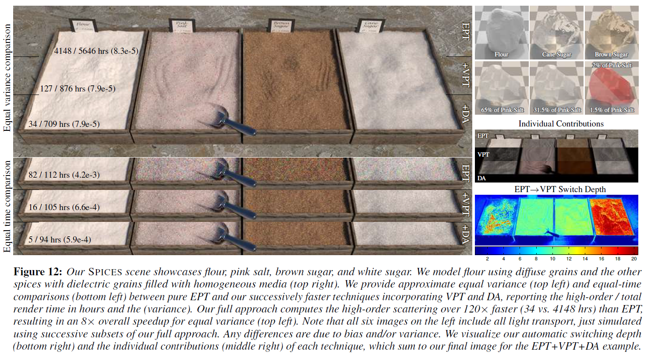
7 Results

Slide 34
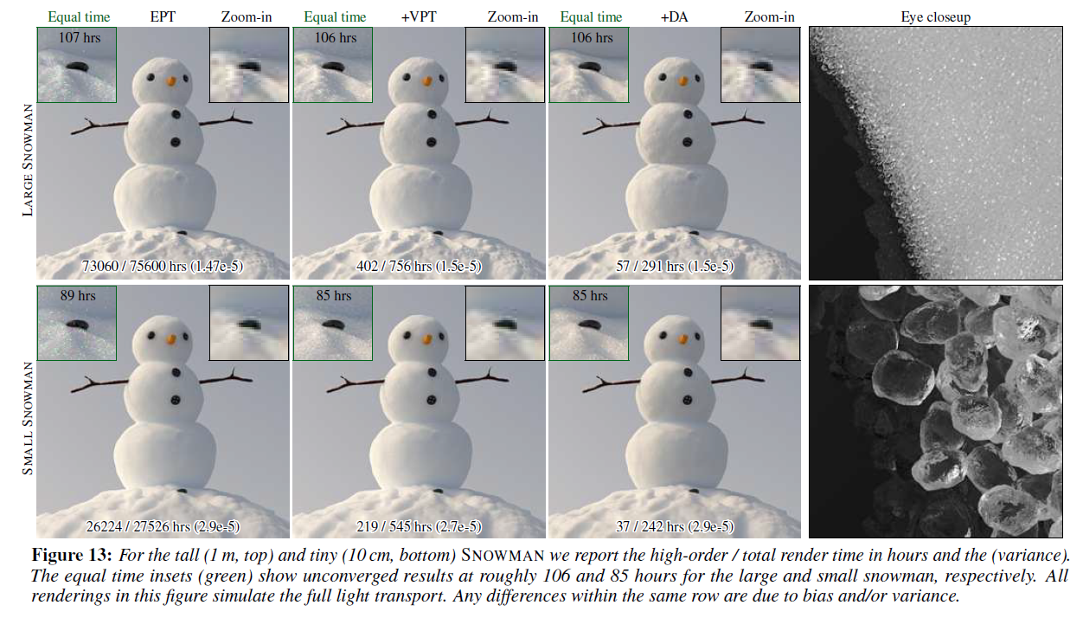
7 Results

Slide 35
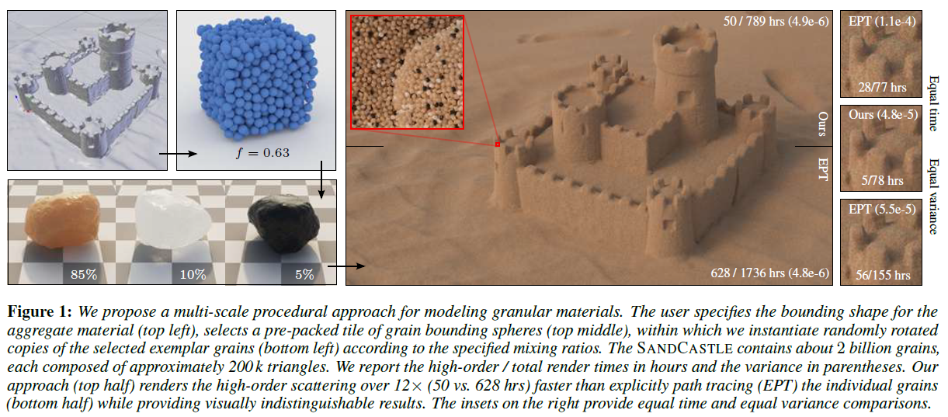
8 Conclusion

Slide 36
References
[1] Meng, J., Papas, M., Habel, R., Dachsbacher, C., Marschner, S., Gross, M. H., & Jarosz, W. (2015). Multi-scale modeling and rendering of granular materials. ACM Trans. Graph., 34(4), 49-1.
[2] Glynn, P. W. (1990). Diffusion approximations. Handbooks in Operations research and management Science, 2, 145-198.
[3] Volumetric Path Tracing (March 2012). Cornell University. http://www.cs.cornell.edu/courses/cs6630/2012sp/ notes/09volpath.pdf
[4] https://github.com/zzdever/Multi-ScaleGranular. Implementation of SIGGRAPH 2015. Multi-Scale Modeling and Rendering of Granular Materials.

Slide 37
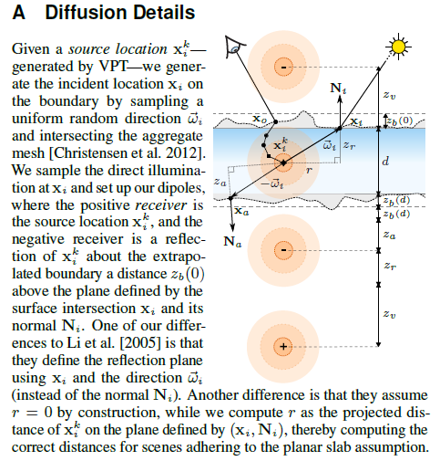
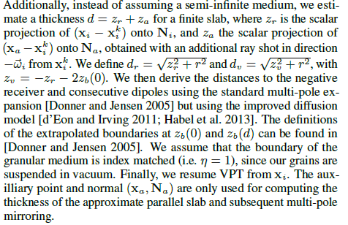
Appendix

Slide 38
THANKS FOR YOUR ATTENTION

